Slide 1

Introduction
COMP.5204 Enterprise

Slide 2
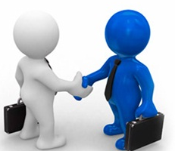

What is Business?
It refers to a form of activity conducted with an objective of earning profits for the benefit of those on whose behalf the conducted is conducted.
“Human activity directed towards producing or acquiring wealth through buying and selling goods.”
(http://bizcommunications coach.com)

Slide 3
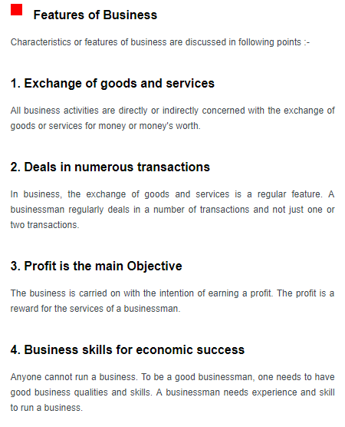

Slide 4
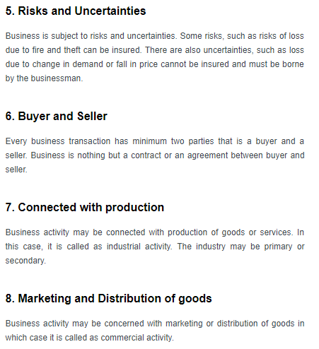

Slide 5
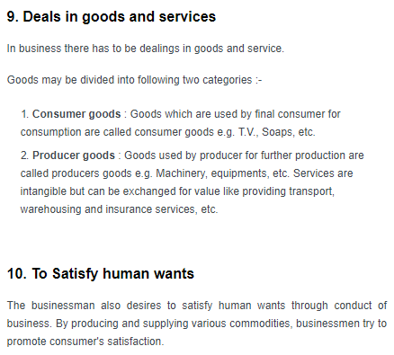

Slide 6

Richard Branson Qoute:

Slide 7

Industry Research
*https://www.business.govt.nz
* https://www.stats.govt.nz

